Slide 1








Cold plasma endotherapy in biliary tree:
From catheter design to
Large-animal studies
Thierry DUFOUR,
Manon SOULIER,
Korentin GERAUD,
Marine CAMUS,
Laura FOUASSIER

Slide 2


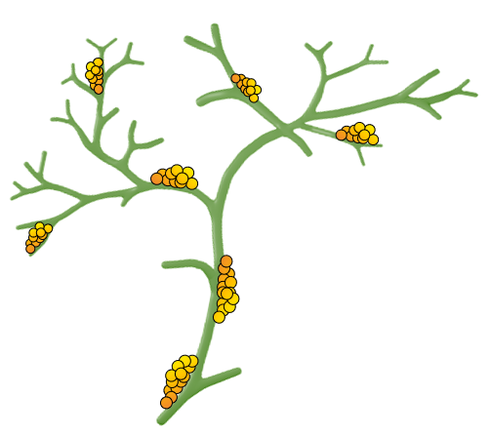
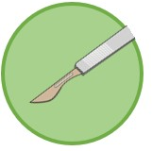

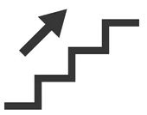
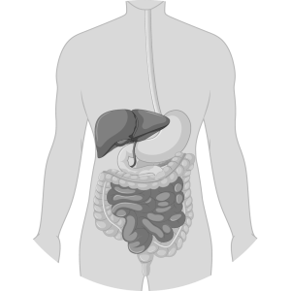
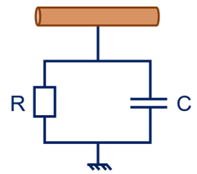
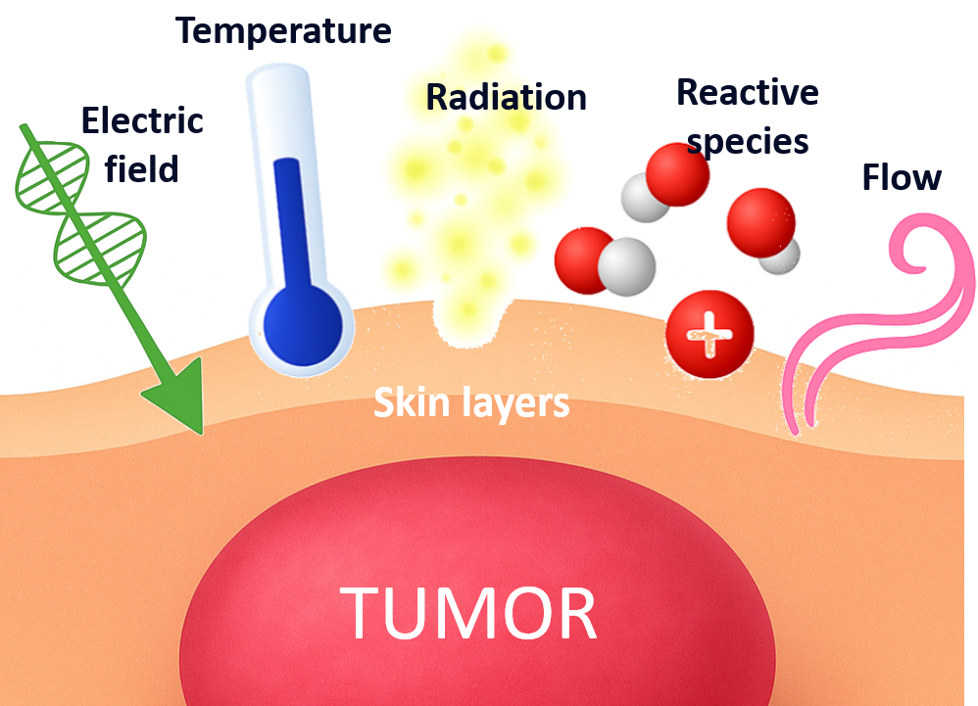
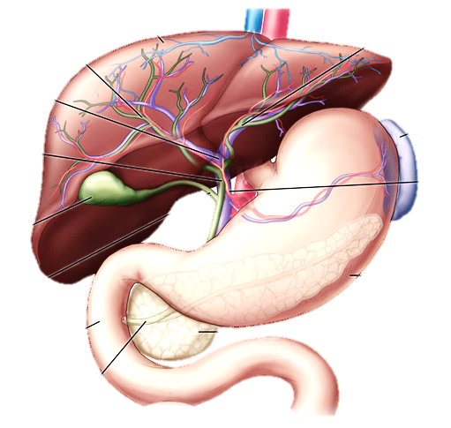
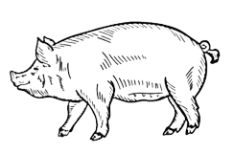
Medical context
01/22
What is cholangiocarcinoma?
Medical
Current therapies at hospital
Surgical resection Chemotherapy
context
Intra vs extra hepatic?
Knowledge
gap
20-30 %
of patients
Non curative
Surgery adjuvent
D. Moris et al., ACS Journals (2023)
model
Artificial biliary
Cold Plasma: disruptive approach
Post-mortem digestive
model
Cholangiocarcinoma = bile duct cancer
Rare: 3-60 persons for 1 billion population/y
Highly lethal: 5-year survival rate of 7-20 %
Asymptomatic in early stage
model
Porcine
Banales J.M. et al. Nat Rev Gastroenterol Hepatol 17, 557–588 (2020)

Slide 3
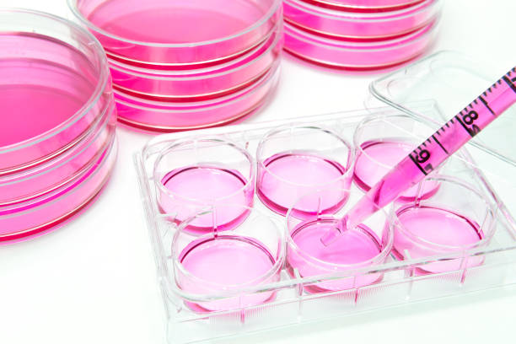
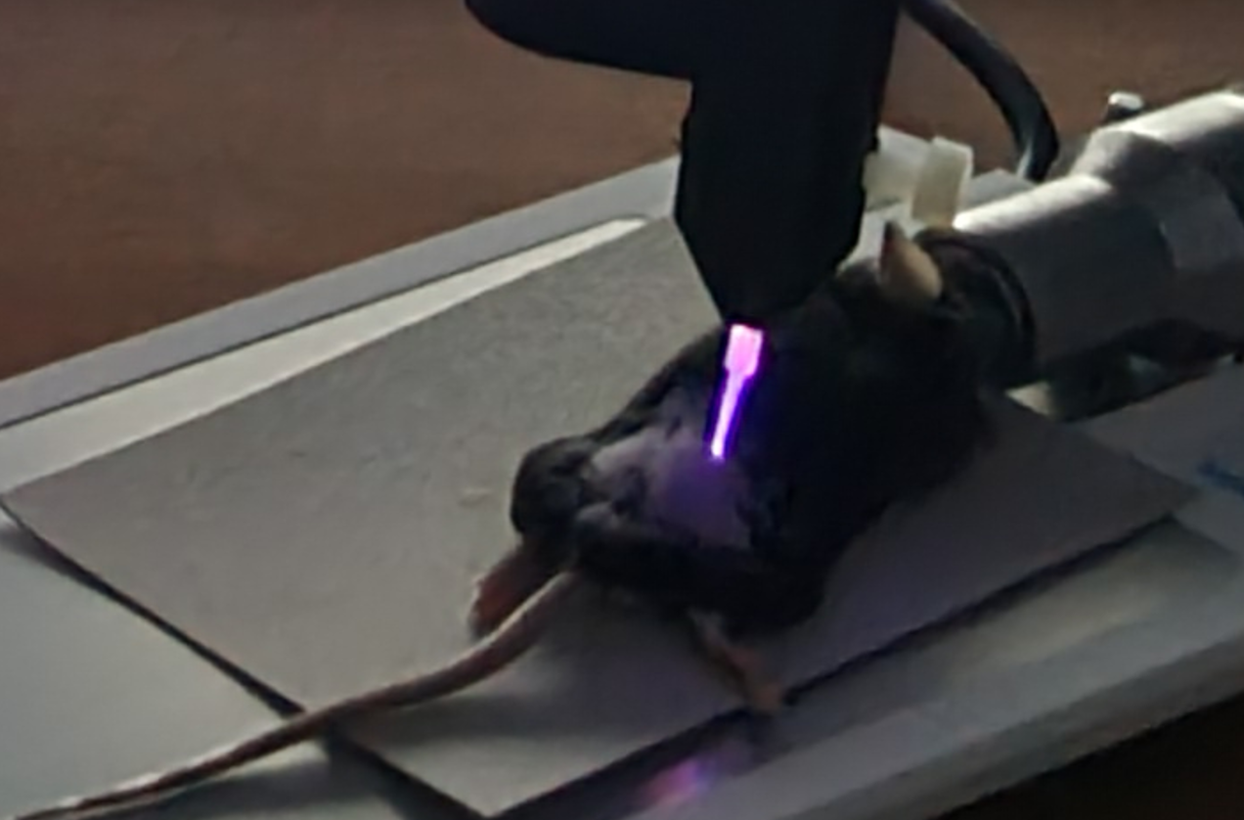
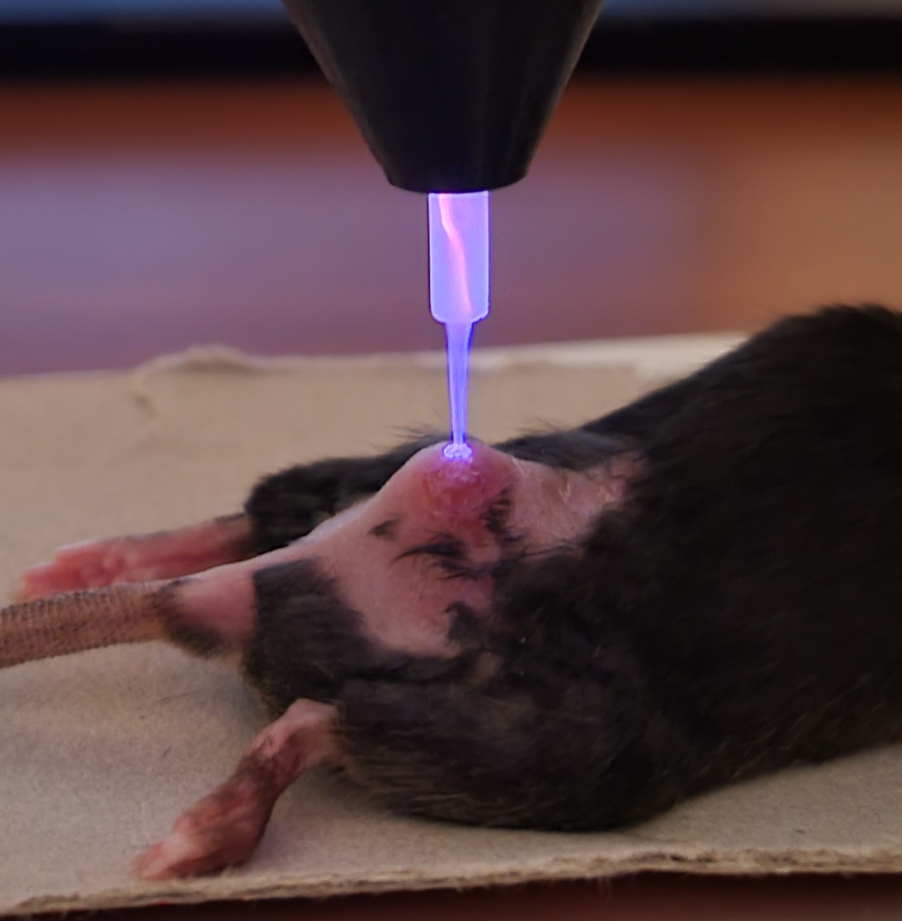
Medical context
02/22
Is cold plasma « therapeutically efficient »?
Medical
In vitro experiments
Human cell lines of CCA (HuCCT1)
(24h post-treatment)
In vivo experiments
Murine cell lines of CCA (SB-1)
(Immunocompetent mice)
context
Knowledge
gap
model
Artificial biliary
100
50
0
350
300
250
200
150
100
50
0
Control group
***
Post-mortem digestive
model
Cell viability (%_{CTRL})
Tumor volume (mm³)
Plasma group
model
Porcine
0 0.5 1 2 3 5
0 2 4 6 8 10
Plasma exposure time (min)
Post-treatment time (days)

Slide 4
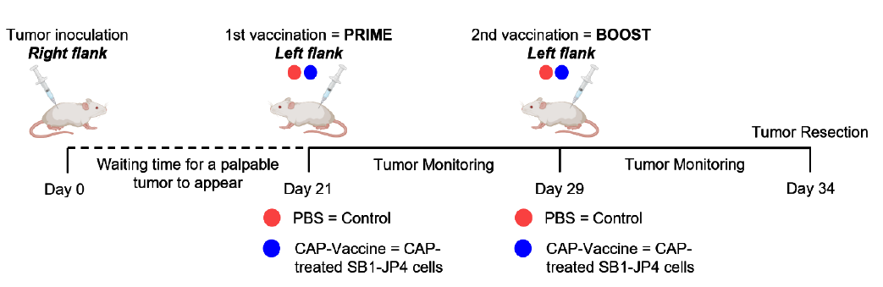
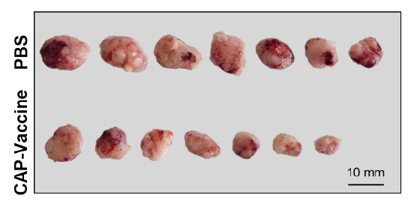
Medical context
02/22
Is cold plasma « therapeutically efficient »?
Medical
In vivo experiments
Murine cell lines of CCA (SB-1)
(Immunocompetent mice)
context
Indirect effects
(Vaccination with CAP-treated tumor cells)
Direct effects
Vaccination
Knowledge
gap
**
**
60
40
20
0
1.0
0.5
0
Tumor-infiltrating NK cells (%)
model
Activated NK cells (%)
Artificial biliary
350
300
250
200
150
100
50
0
**
**
PBS CAP-Vaccine
PBS CAP-Vaccine
Control group
***
60
40
20
0
Post-mortem digestive
1.0
0.5
0
model
Tumor volume (mm³)
Tumor-infiltrating NK cells (%)
Activated NK cells (%)
Plasma group
model
Porcine
0 2 4 6 8 10
PBS CAP-Vaccine
PBS CAP-Vaccine
A. Pavy & L. Fouassier
Post-treatment time (days)
The % of tumor-infiltrating NK cells is significantly increased in the CAP-vaccine group compared with the PBS control group. Vaccination with CAP-treated tumor cells promotes the recruitment/infiltration of NK cells into the TME.
The percentage of activated NK cells is significantly higher in the CAP-vaccine group than in the PBS group. This indicates that vaccination not only increases NK cell infiltration, but also enhances their activation status.
These activated NK cells may therefore contribute more effectively to the antitumor immune response induced by CAP vaccination.

Slide 5
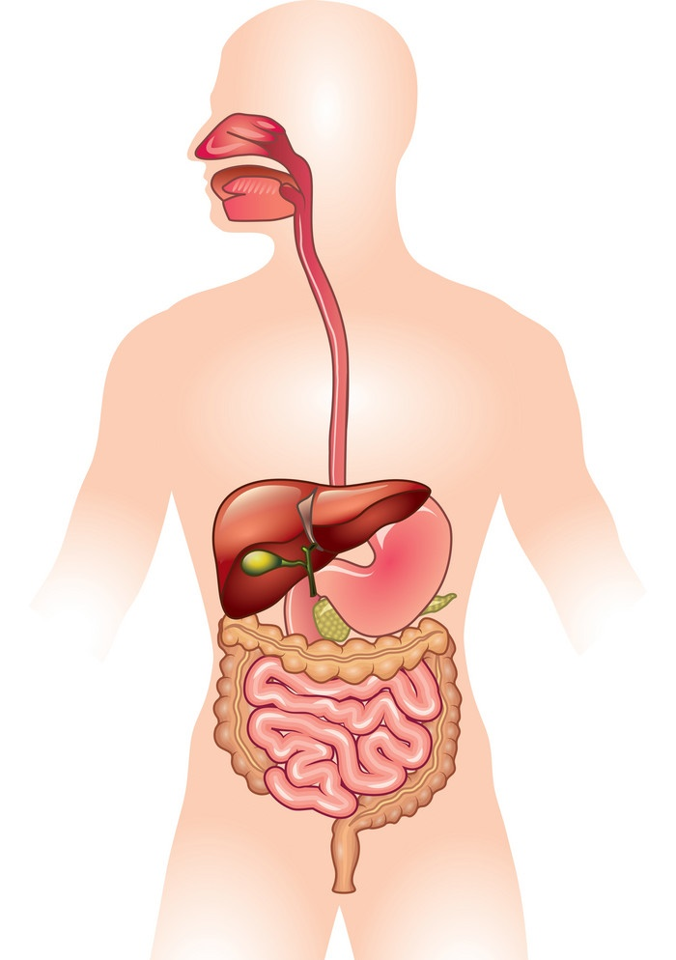
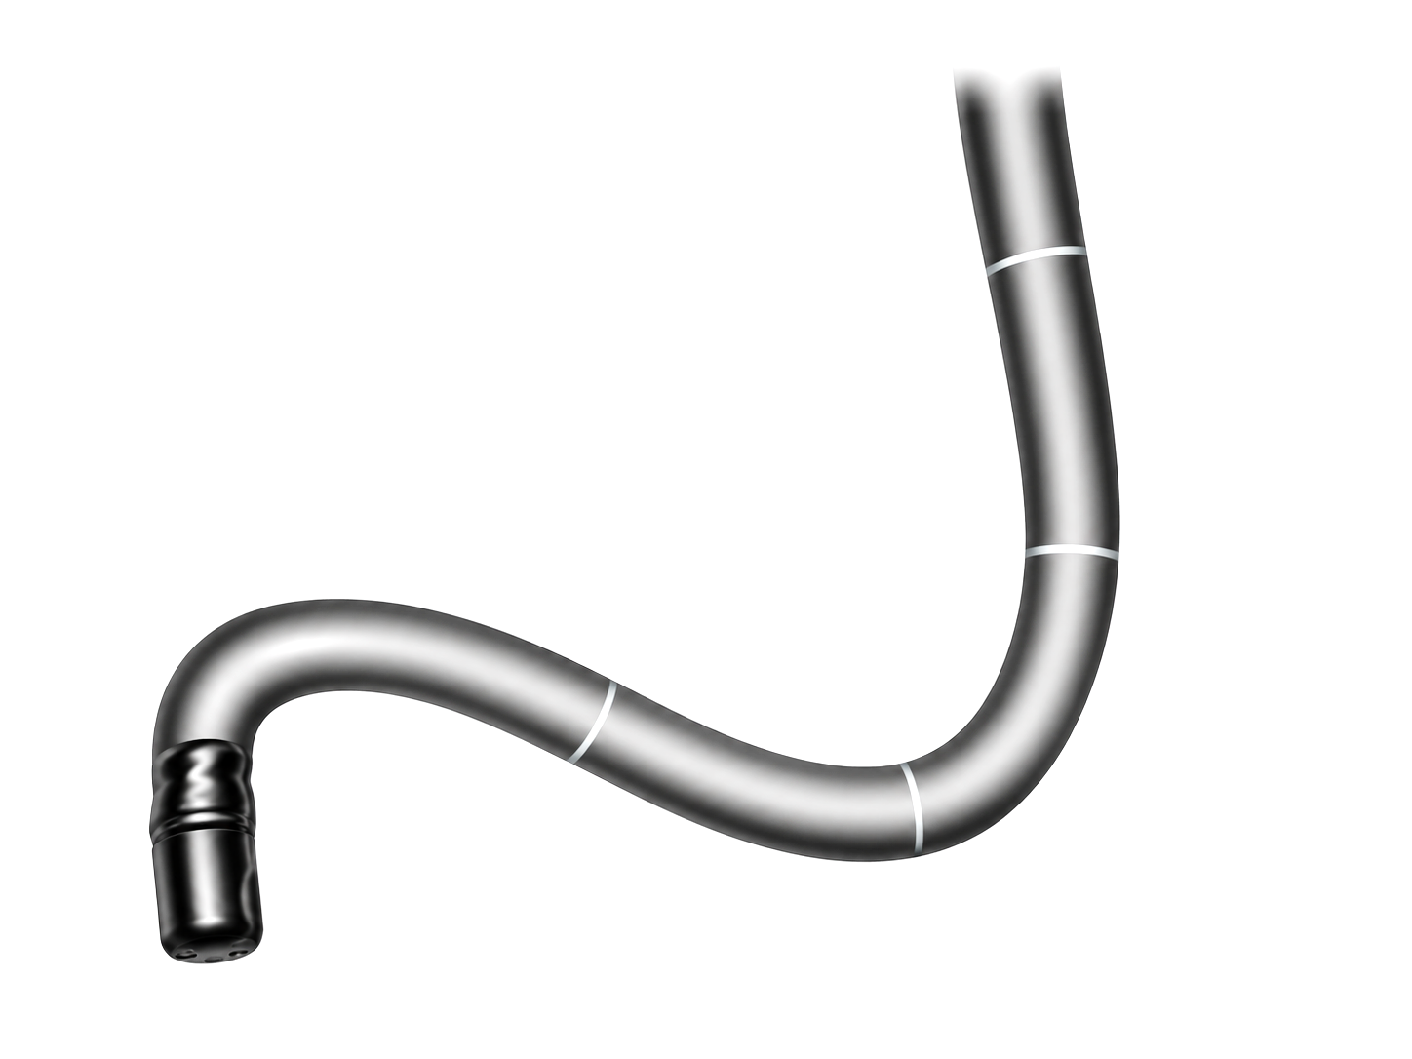
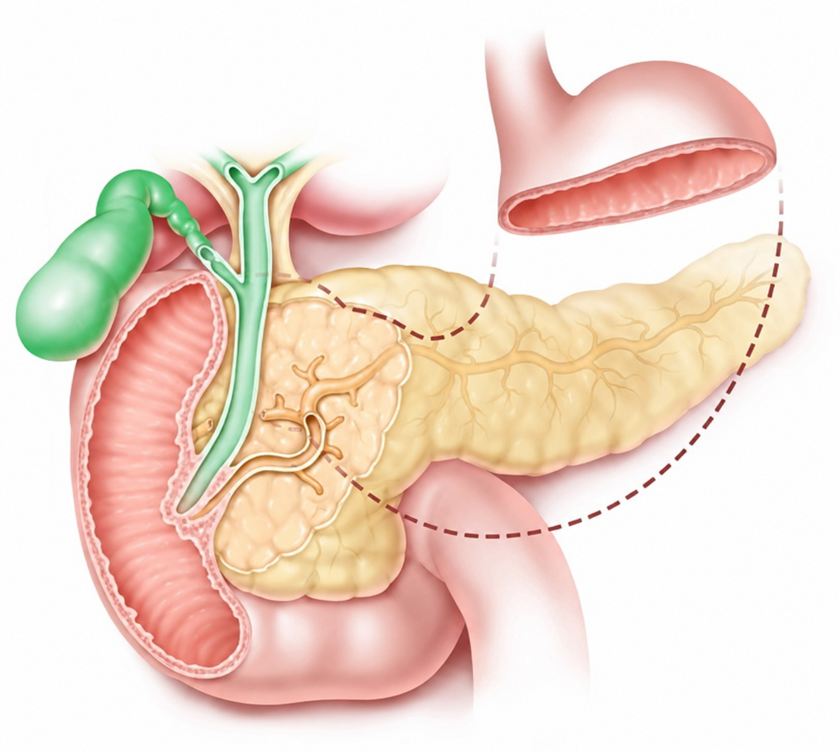
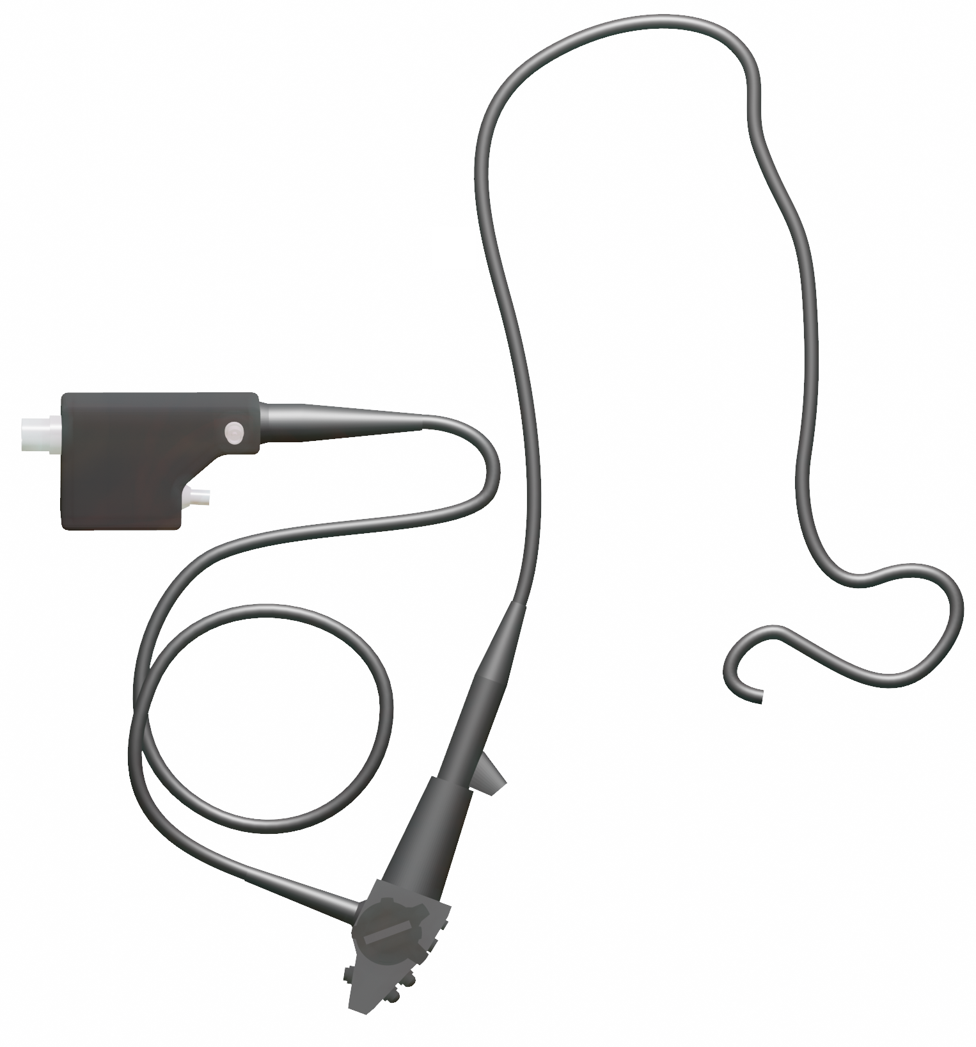
Knowledge gap
03/22
How to transfer the technology from « mouse to human »?
Medical
context
Common
bile duct
Stomach
Knowledge
Gallbladder
gap
Duodenoscope
Pancreas
model
Artificial biliary
Duodenoscope
Post-mortem digestive
model
Duodenum
model
Porcine
(cross-section view)

Slide 6
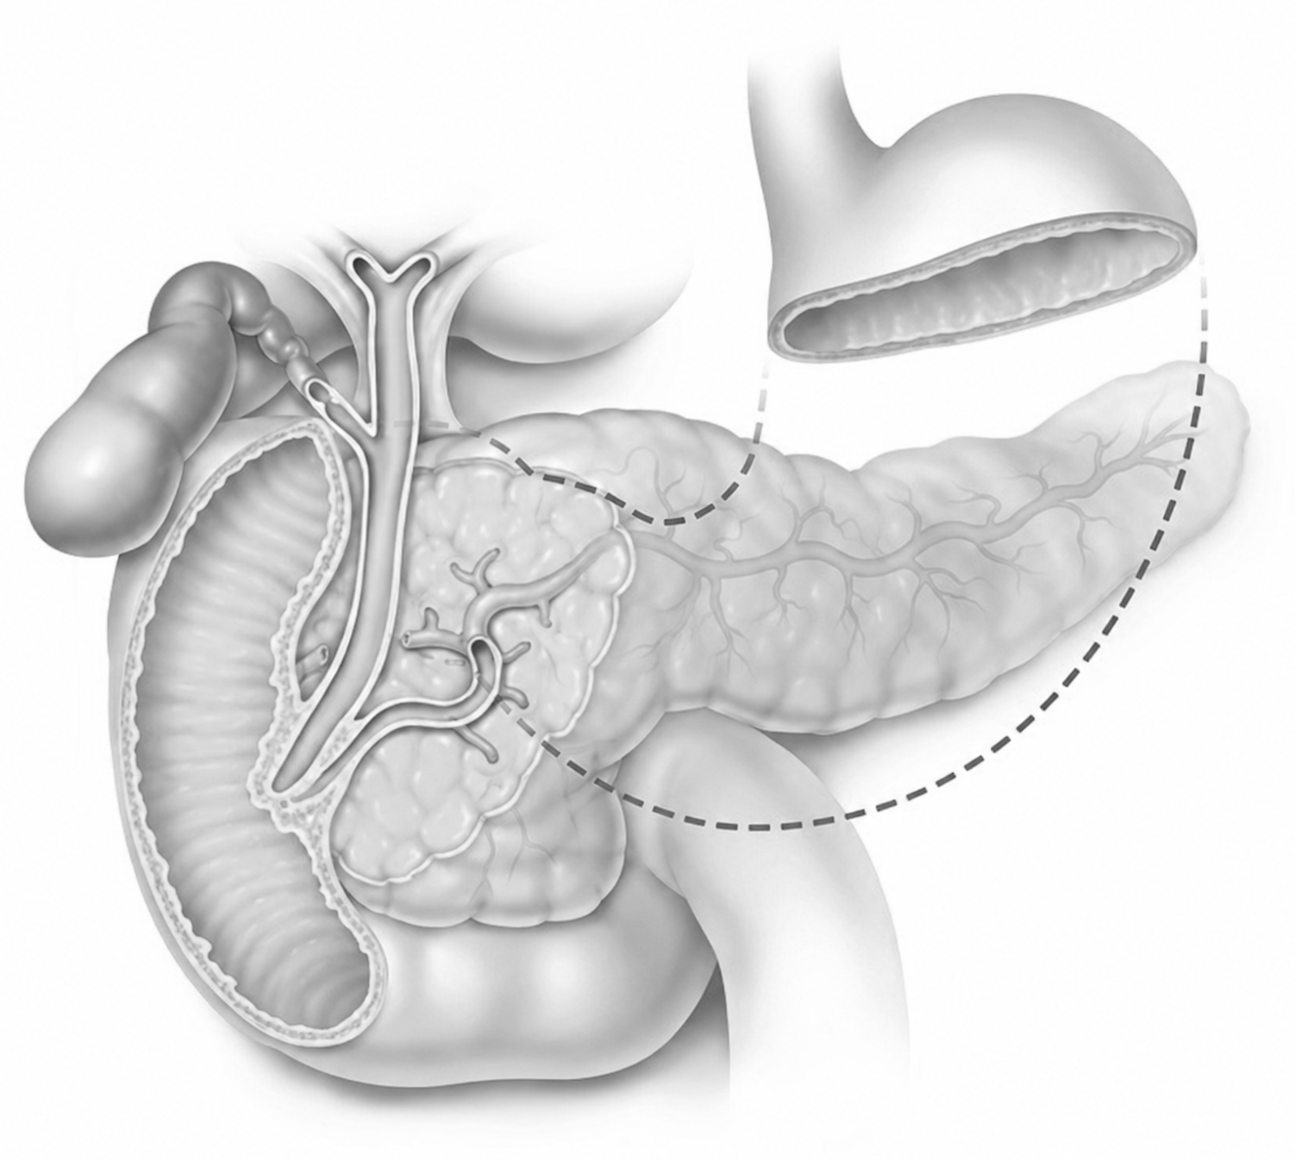
Knowledge gap
03/22
How to transfer the technology from « mouse to human »?
Medical
context
Common
bile duct
Stomach
Knowledge
Gallbladder
gap
Duodenoscope
Pancreas
model
Artificial biliary
Duodenoscope
Post-mortem digestive
model
Duodenum
model
Porcine
(cross-section view)

Slide 7
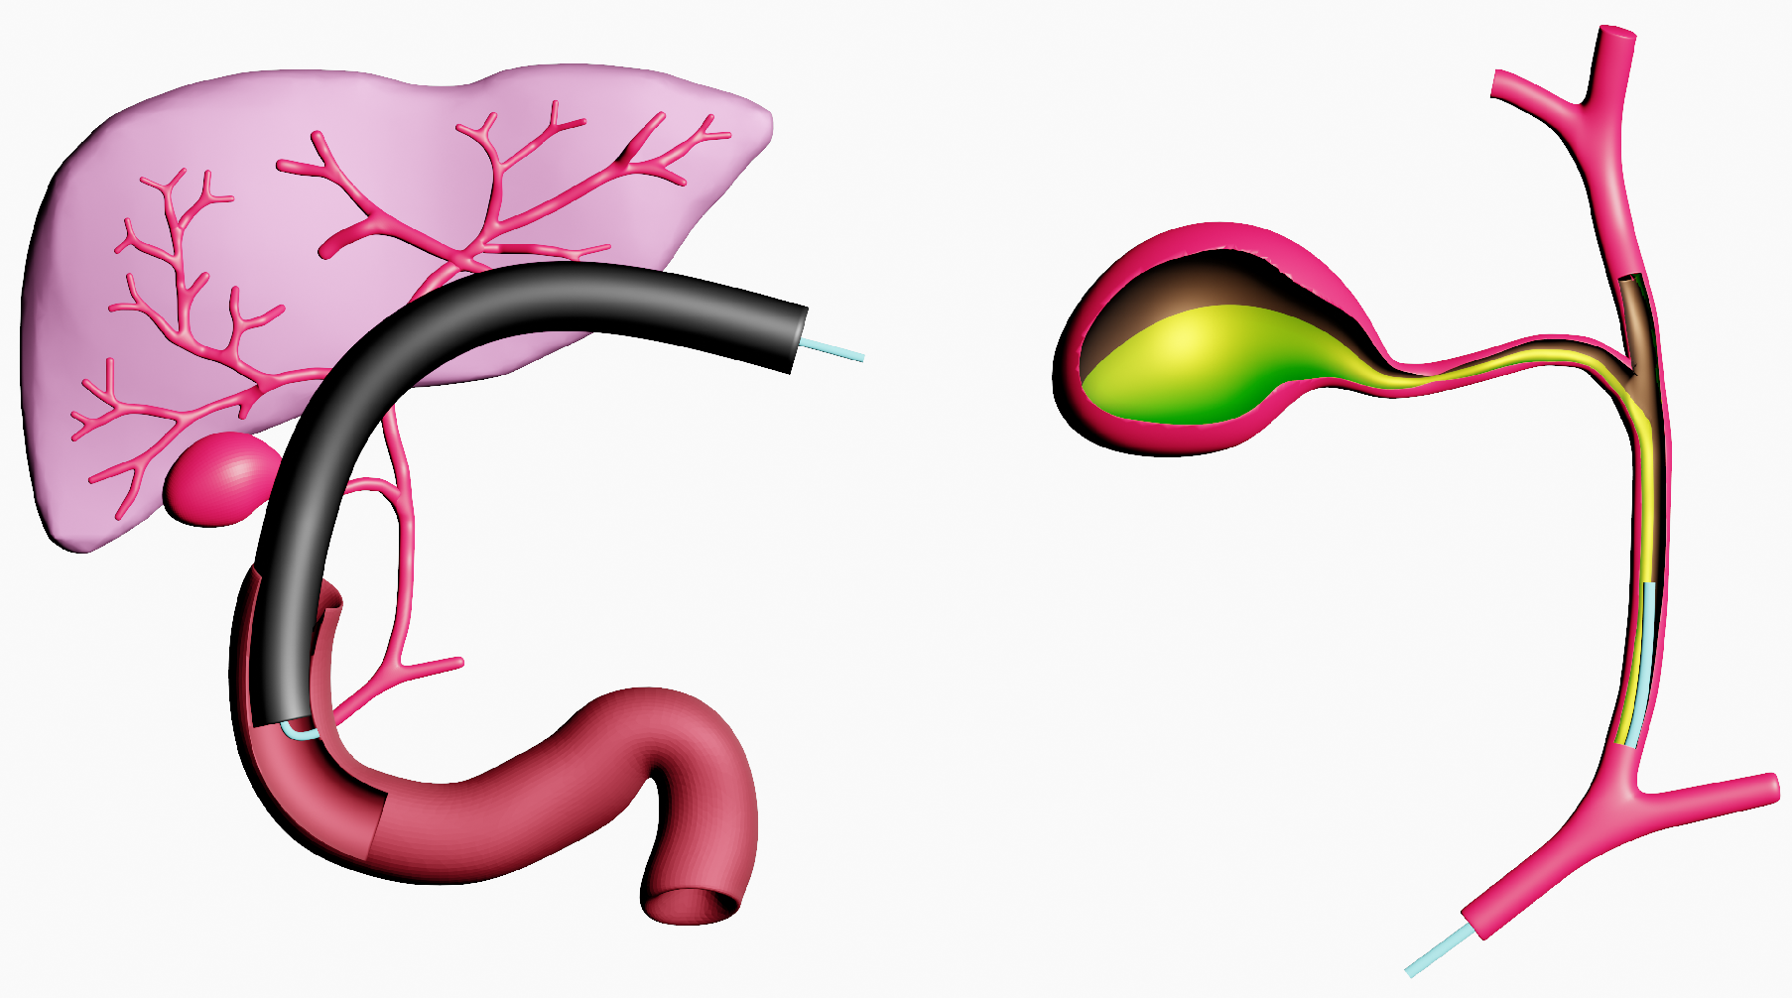


Knowledge gap
03/22
How to transfer the technology from « mouse to human »?
Medical
Common bile duct
Choledoc
Cystic duct
Gallbladder
Bile ducts constraints
- Confined environment
 No gas outlet
 Overpressure
- Parietal treatment → CCA
- Axial treatment → Stenosis
context
Knowledge
gap
–
+
+
–
–
+
–
+
+
–
+
–
–
+
model
–
Artificial biliary
+
Bile liquid constraints
- High electrical conductivity
- Discontinuous flow
- Surfactants
Post-mortem digestive
model
Plasma
catheter
model
Porcine

Slide 8
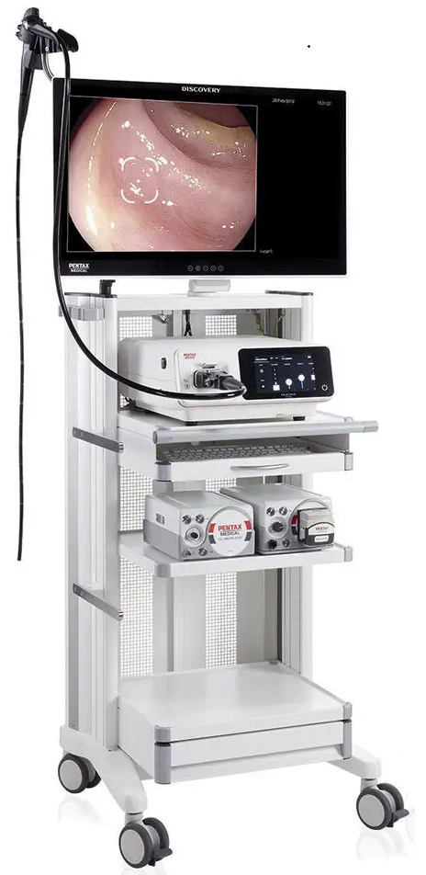
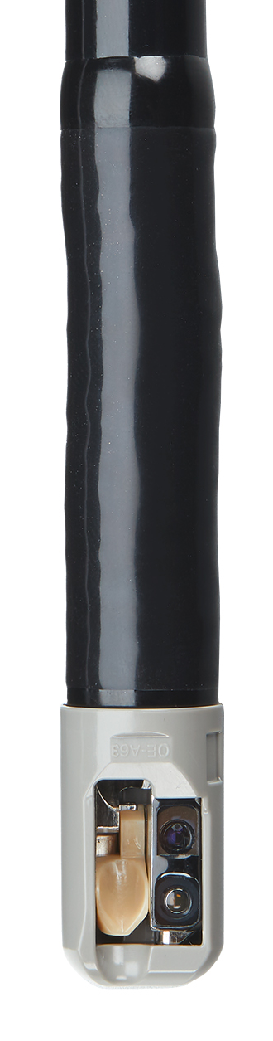
Knowledge gap
04/22
Which constraints? Which challenges?
Medical
Common bile duct
Choledoc
Cystic duct
Gallbladder
Bile ducts constraints
- Confined environment
 No gas outlet
 Overpressure
- Parietal treatment → CCA
- Axial treatment → Stenosis
context
Knowledge
gap
–
+
+
–
–
+
–
+
+
–
+
–
–
+
model
–
Artificial biliary
+
Bile liquid constraints
- High electrical conductivity
- Discontinuous flow
- Surfactants
Post-mortem digestive
model
Clinical device constraints
- Highly flexible
- Diameter < 4.2 mm
- Length > 2 meters
- X-rays imaging
Plasma
catheter
model
Porcine

Slide 9
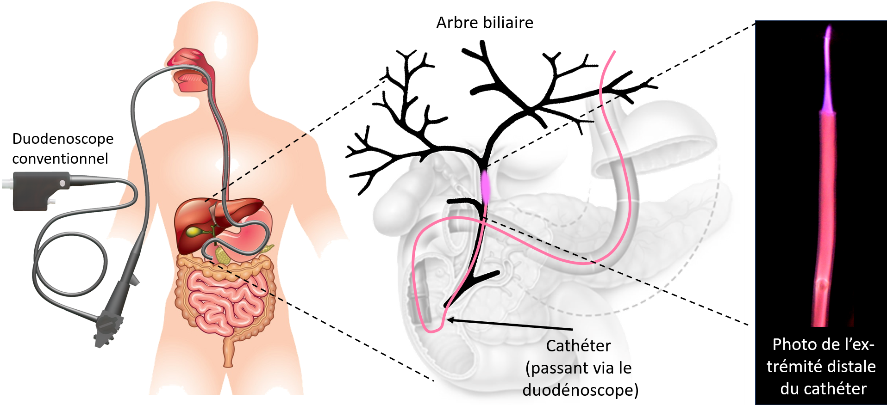
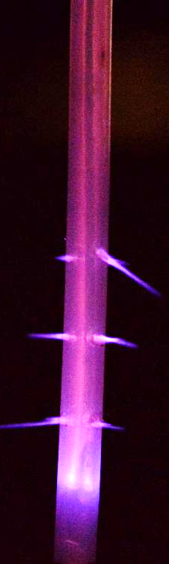
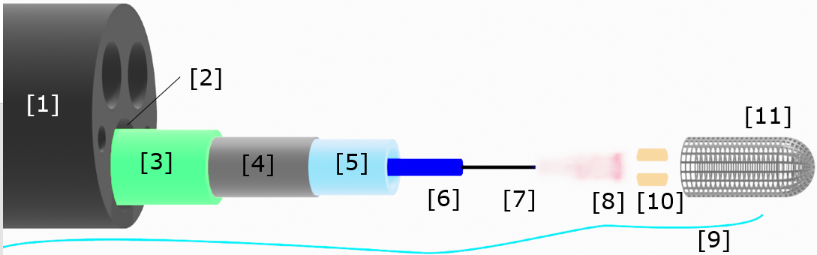
Knowledge gap
04/22
Which constraints? Which challenges?
Medical
context
Knowledge
gap
model
Artificial biliary
Post-mortem digestive
model
model
Porcine

Slide 10
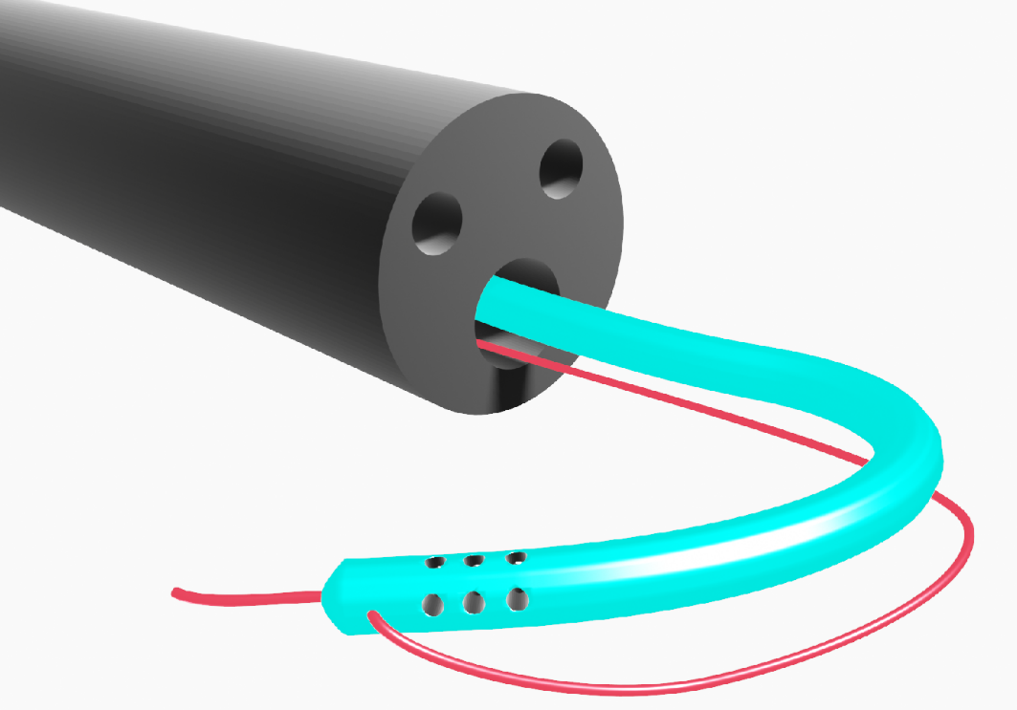
Knowledge gap
04/22
Which constraints? Which challenges?
Medical
context
Duodenoscope
Knowledge
gap
Catheter
model
Artificial biliary
Operating
channel
Post-mortem digestive
model
Guide wire
model
Porcine

Slide 11


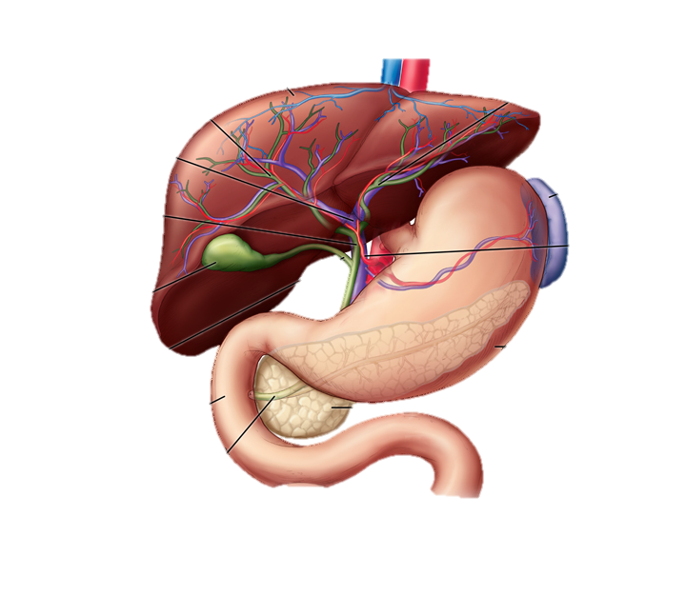
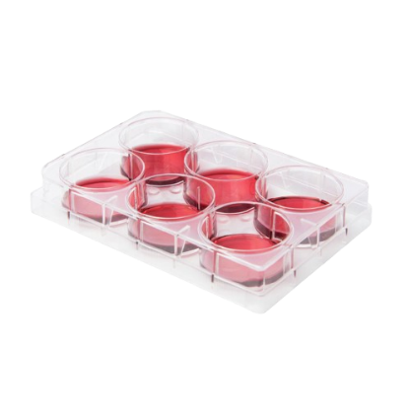

Knowledge gap
05/22
Roadmap: upgrading preclinical models before clinical trials
Medical
context
Alive
porcine
model
Patient
Knowledge
gap
Post-mortem digestive porcine model
model
Artificial biliary
Post-mortem digestive
model
Artificial
biliary model
model
Porcine
In vitro model
Murine model

Slide 12
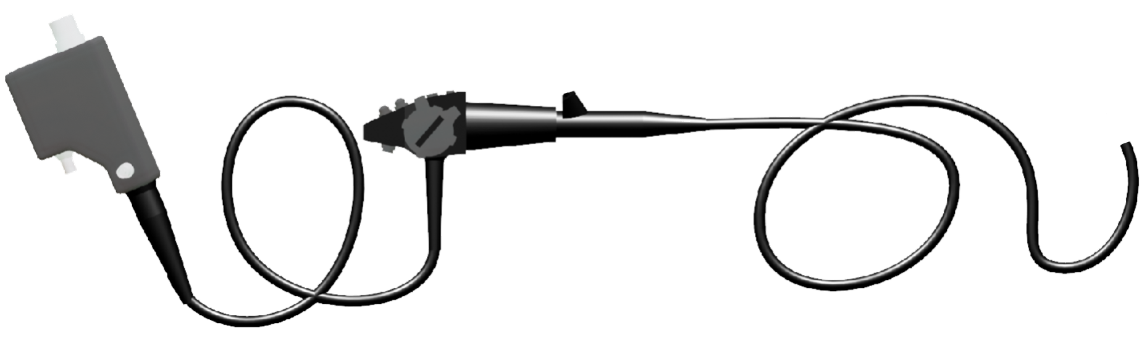



Artificial biliary model
06/22
How to engineer an equivalent electrical model of bile duct?
Entrance of operation channel
IR camera
Medical
context
Proximal
control
handle
Knowledge
gap
Insertion tube
I_{max}
Human bile duct
Artificial biliary model
$$σ_{bile}$$
10
model
Artificial biliary
Copper tube
1
$$σ_{water}^{tap}$$
Ø 6 mm
Post-mortem digestive
model
Electrical conductivity (mS/cm)
R
10⁻¹
Ø 6 mm
10⁻²
model
Porcine
$$σ_{water}^{demin}$$
C
Bile substitute
10⁻³

Slide 13
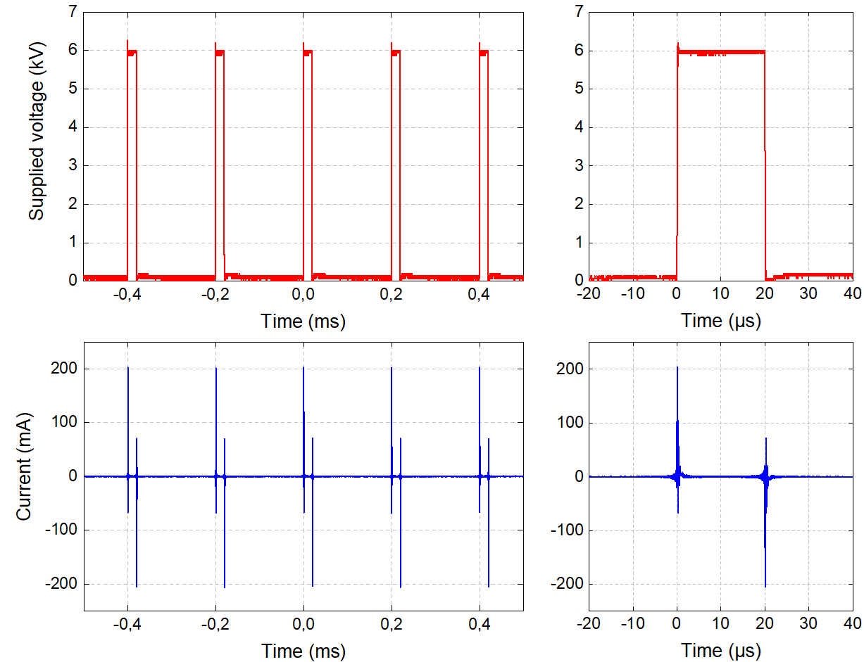
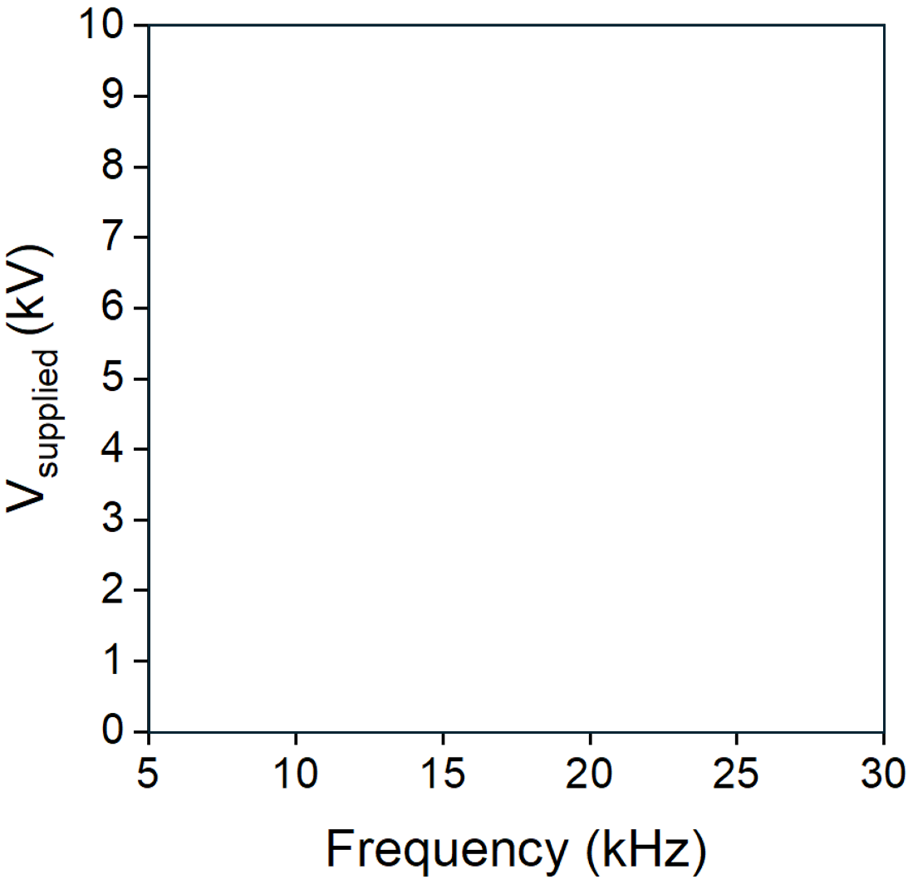
Artificial biliary model
07/22
Defining a safe operational window / Electricity
Medical
With bile substitute
context
Typical voltage profile (6 kV, 5 kHz, 10%)
Filamentary to-arc region
Knowledge
gap
model
Artificial biliary
Post-mortem digestive
model
No gas breakdown
model
Porcine

Slide 14
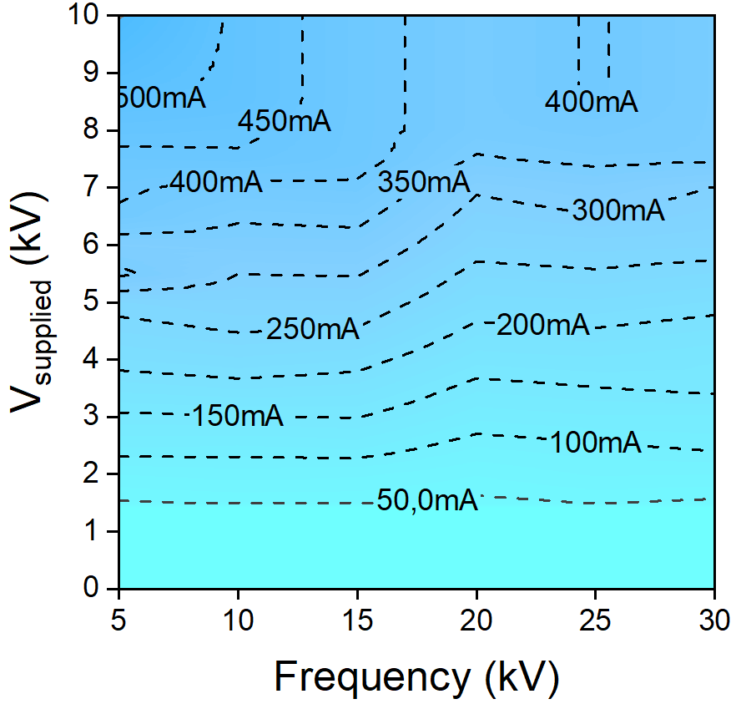
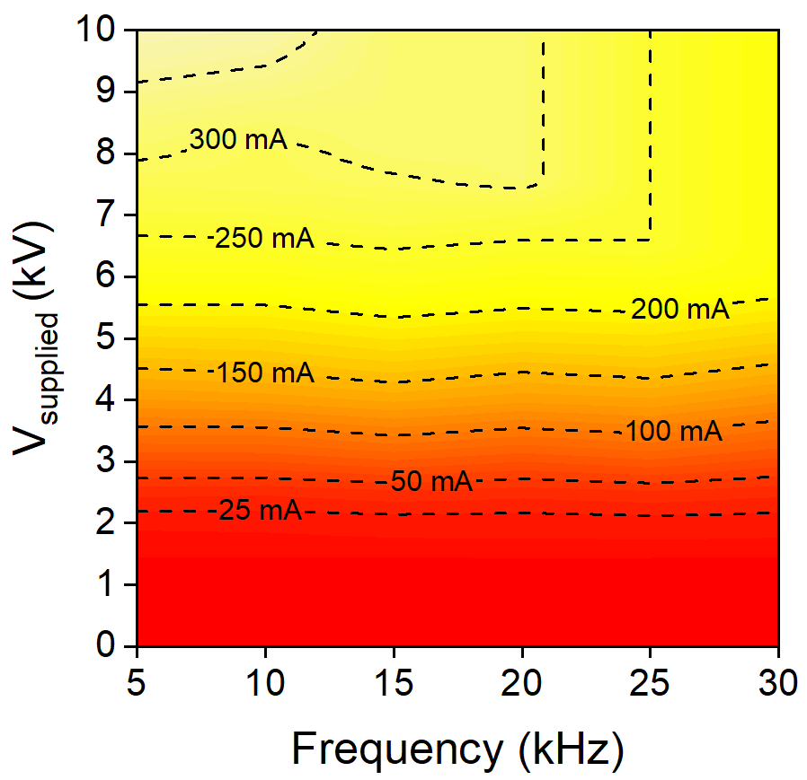
Artificial biliary model
07/22
Defining a safe operational window / Electricity
Medical
With bile substitute
context
Typical voltage profile
Without bile substitute
Filamentary to-arc region
Filamentary to-arc region
Knowledge
gap
model
Artificial biliary
Typical current profile
Pulse FWHM
= 150 ns
Post-mortem digestive
model
No gas breakdown
No gas breakdown
model
Porcine

Slide 15
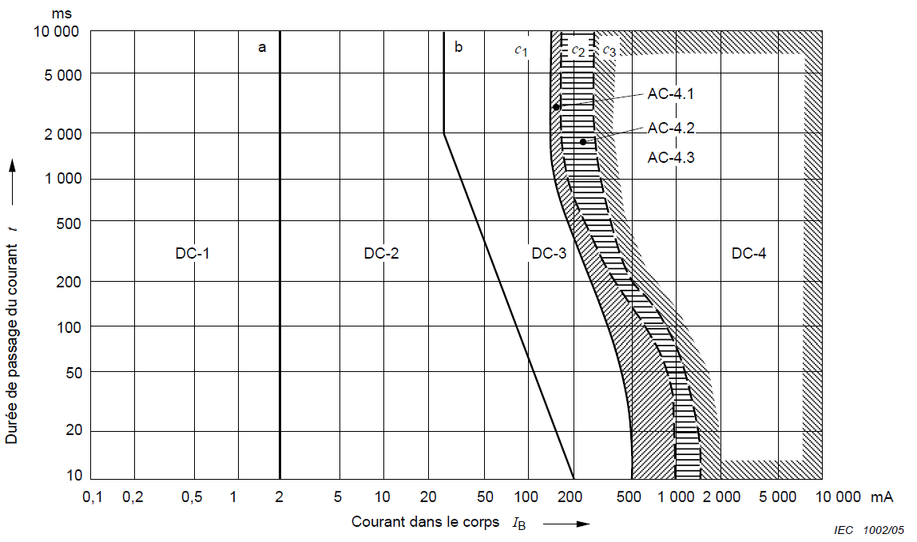
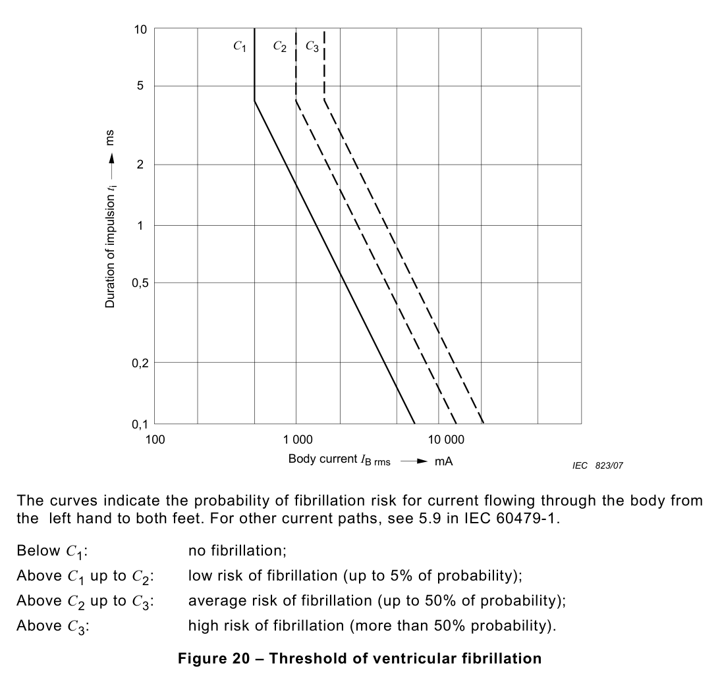
Artificial biliary model
08/22
Defining a safe operational window / Electricity
Medical
Technical specifications
(IEC, International Electrotechnical Commission)
With bile substitute
context
CEI 60479-1
Filamentary to-arc region
Knowledge
gap
model
Artificial biliary
CEI 60479-2
Post-mortem digestive
model
No gas breakdown
model
Porcine

Slide 16
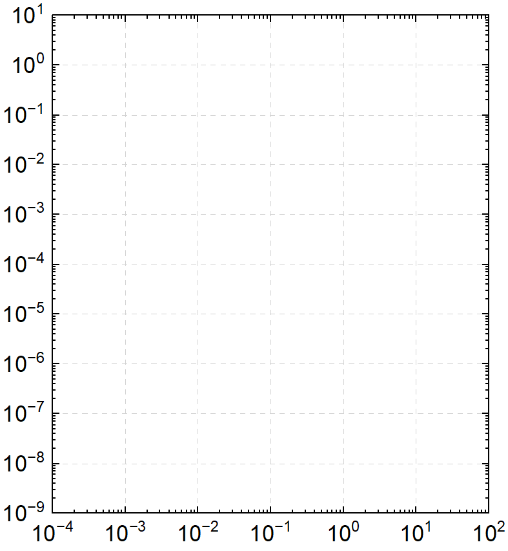
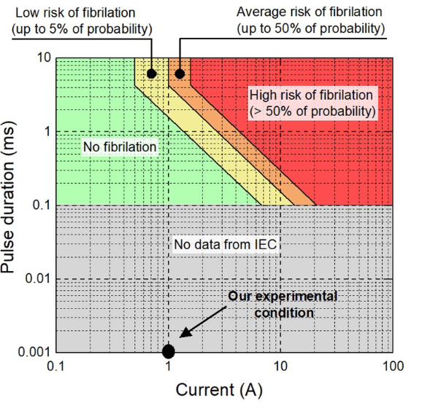


Artificial biliary model
08/22
Defining a safe operational window / Electricity
b
c₁
c₂
c₃
Medical
With bile substitute
context
DC-3
DC-1
DC-2
DC-4.2
DC-4.3
Filamentary to-arc region
DC-4.1
Knowledge
gap
Duration of 1 current pulse (s)
Pulse duration (ms)
model
Artificial biliary
Slight tingling sensation possible
Involuntary muscle contractions
Strong involuntary muscle contractions
Probability of ventricular fibrillation: 0-5%.
Probability of ventricular fibrillation: 5-50%.
Probability of ventricular fibrillation: >50%.
Our
condition
Post-mortem digestive
model
No gas breakdown
Our experimental conditions !!
Current magnitude (A)
model
Porcine
International Electrotechnical Commission (IEC) standards
RMS body current(A)

Slide 17
Artificial biliary model
09/22
Defining a safe operational window / Electricity
Medical
Sequence of N pulses
Parameters
Current pulse duration
RMS body current
Pulse repetition frequency
Rest time between 2 current pulses (τ_{2pulses})
τ_{2pulses} ≈ 20 µs
If τ_{2pulses} < Cardiac period (0.86s)
Cumulative effects: at each new pulse, the fibrillation roof decreases → Risks are enhanced.
context
Filamentary to-arc region
Knowledge
gap
model
Artificial biliary
Post-mortem digestive
Ventricular
model
No gas breakdown
fibrillation
roof
model
Porcine
τ_{2pulses}

Slide 18
Artificial biliary model
09/22
Defining a safe operational window / Electricity
Medical
Sequence of N pulses
Parameters
Current pulse duration
RMS body current
Pulse repetition frequency
Rest time between 2 current pulses (τ_{2pulses})
τ_{2pulses} ≈ 20 µs
If τ_{2pulses} < Cardiac period (0.86s)
Cumulative effects: at each new pulse, the fibrillation roof decreases → Risks are enhanced.
context
Filamentary to-arc region
Knowledge
gap
model
Artificial biliary
Post-mortem digestive
model
Our plasma physics goes beyond IEC standards
Current pulse durations are too short
Alternance of positive & negative pulses
No gas breakdown
model
Porcine

Slide 19
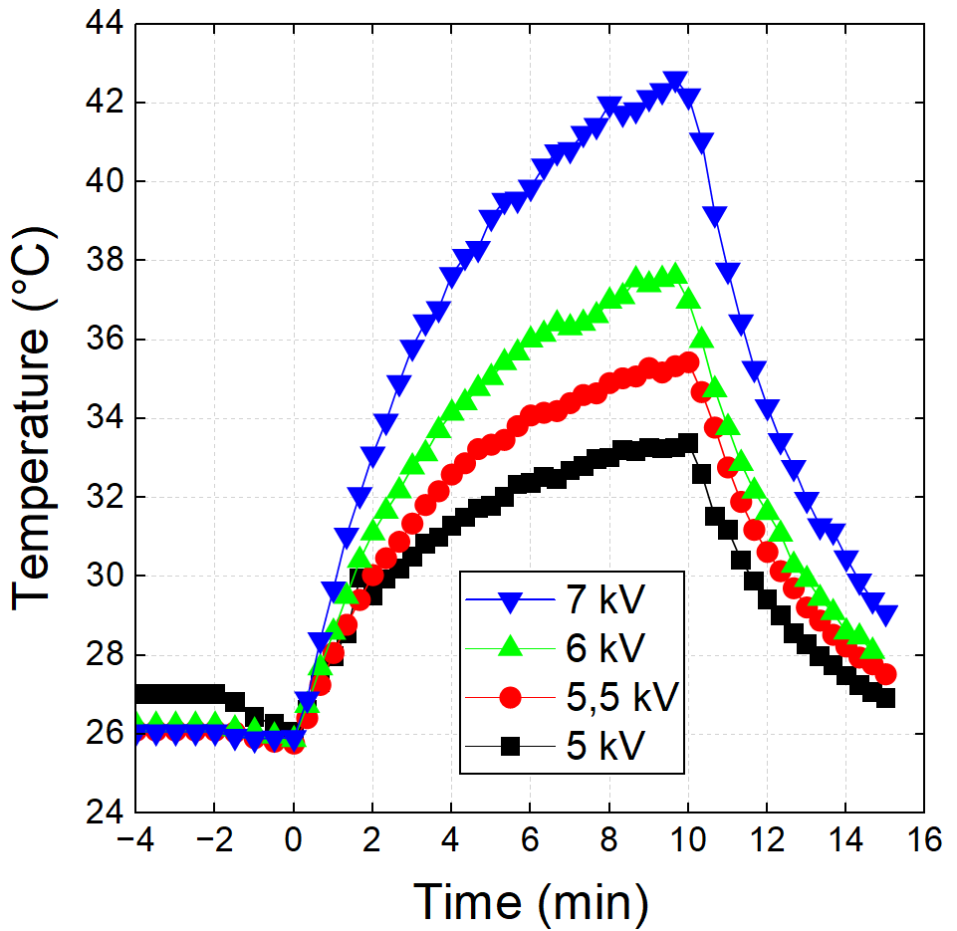
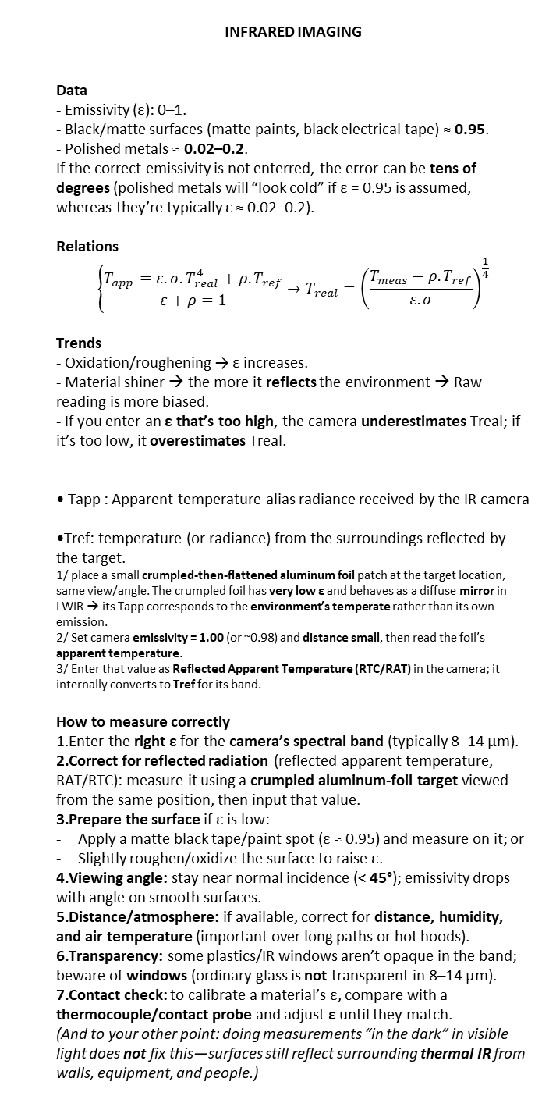
Artificial biliary model
10/22
Defining a safe operational window / Temperature
Medical
INFRARED IMAGING
Data
- Emissivity (ε): 0–1.
- Black/matte surfaces (matte paints, black electrical tape) ≈ 0.95.
- Polished metals ≈ 0.02–0.2.
If the correct emissivity is not enterred, the error can be tens of degrees (polished metals will “look cold” if ε = 0.95 is assumed, whereas they’re typically ε ≈ 0.02–0.2).
Relations
$$\left\{\begin{aligned}T_{app}=ε.σ.T_{real}^{4}+ρ.T_{ref} \\ ε+ρ=1\end{aligned}\right.→T_{real}={\left(\frac{T_{meas}−ρ.T_{ref}}{ε.σ}\right)}^{\frac{1}{4}}$$
Trends
- Oxidation/roughening → ε increases.
- Material shiner → the more it reflects the environment → Raw reading is more biased.
- If you enter an ε that’s too high, the camera underestimates Treal; if it’s too low, it overestimates Treal.
Tapp : Apparent temperature alias radiance received by the IR camera
Tref: temperature (or radiance) from the surroundings reflected by the target.
1/ place a small crumpled-then-flattened aluminum foil patch at the target location, same view/angle. The crumpled foil has very low ε and behaves as a diffuse mirror in LWIR → its Tapp corresponds to the environment’s temperate rather than its own emission.
2/ Set camera emissivity = 1.00 (or ~0.98) and distance small, then read the foil’s apparent temperature.
3/ Enter that value as Reflected Apparent Temperature (RTC/RAT) in the camera; it internally converts to Tref for its band.
How to measure correctly
Enter the right ε for the camera’s spectral band (typically 8–14 µm).
Correct for reflected radiation (reflected apparent temperature, RAT/RTC): measure it using a crumpled aluminum-foil target viewed from the same position, then input that value.
Prepare the surface if ε is low:
Apply a matte black tape/paint spot (ε ≈ 0.95) and measure on it; or
Slightly roughen/oxidize the surface to raise ε.
Viewing angle: stay near normal incidence (< 45°); emissivity drops with angle on smooth surfaces.
Distance/atmosphere: if available, correct for distance, humidity, and air temperature (important over long paths or hot hoods).
Transparency: some plastics/IR windows aren’t opaque in the band; beware of windows (ordinary glass is not transparent in 8–14 µm).
Contact check: to calibrate a material’s ε, compare with a thermocouple/contact probe and adjust ε until they match.
(And to your other point: doing measurements “in the dark” in visible light does not fix this—surfaces still reflect surrounding thermal IR from walls, equipment, and people.)
context
Plasma
OFF
Plasma
ON
Plasma
OFF
Filamentary to-arc region
Knowledge
gap
model
Artificial biliary
Post-mortem digestive
model
No gas breakdown
model
Porcine
(Without bile substitute)

Slide 20
Artificial biliary model
10/22
Defining a safe operational window / Temperature & Electricity
Medical
context
Plasma
OFF
Plasma
ON
Plasma
OFF
Without bile substitute
Filamentary to-arc region
Filamentary to-arc region
Knowledge
gap
T > 40 °C
T > 40 °C
model
Artificial biliary
Post-mortem digestive
model
No gas breakdown
No gas breakdown
model
Porcine
Safe Operating Window: 5-7 kV & 5-10 kHz
(Without bile substitute)
With bile substitute

Slide 21
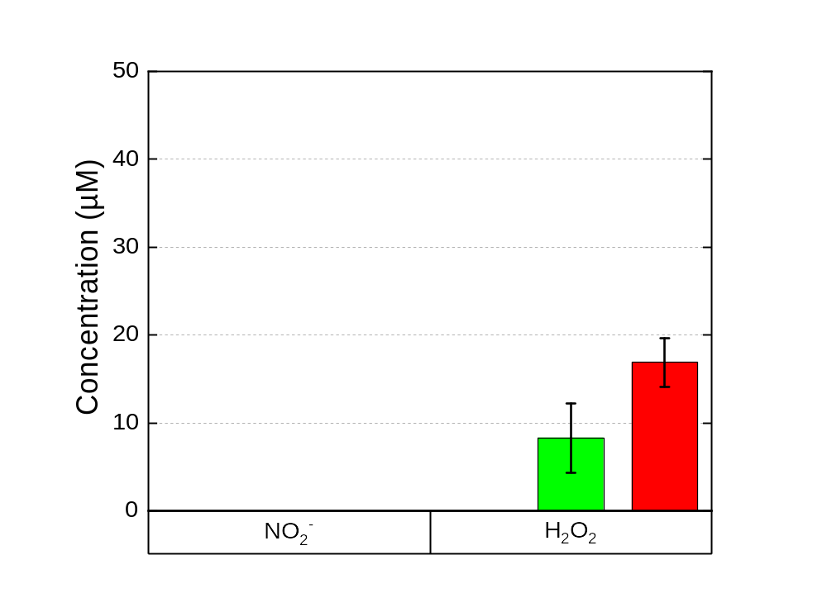
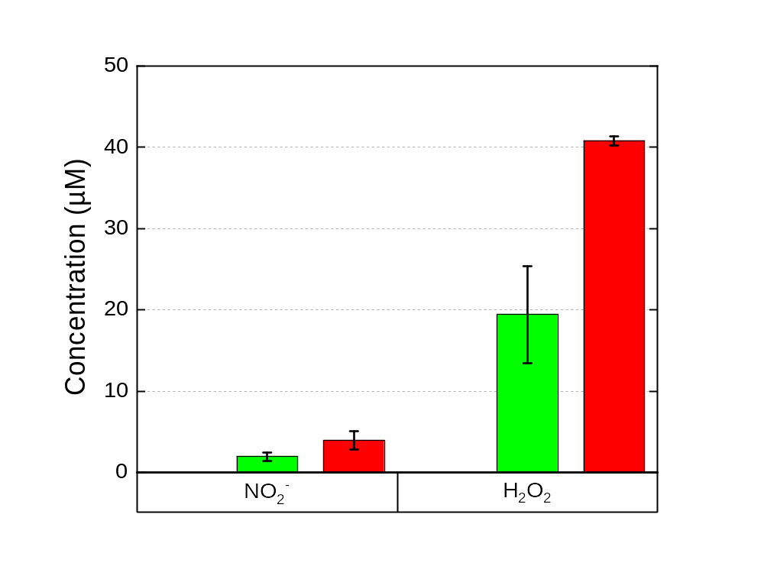
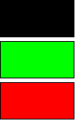
Artificial biliary model
Antitumoral potential: RONS concentration in liquid
Medical
Submerged catheter
Catheter with 4mm liquid gap
context
Treatment time = 10 min
No plasma
5 kHz – 6 kV
10 kHz – 6 kV
Treatment time = 10 min
No plasma
5 kHz – 6 kV
10 kHz – 6 kV
Knowledge
gap
model
Artificial biliary
Post-mortem digestive
model
Worst scenario
No interaction with gas phase
H₂O₂ significant production
More realistic scenario
Interaction with gas phase
Increase in RONS production
model
Porcine

Slide 22
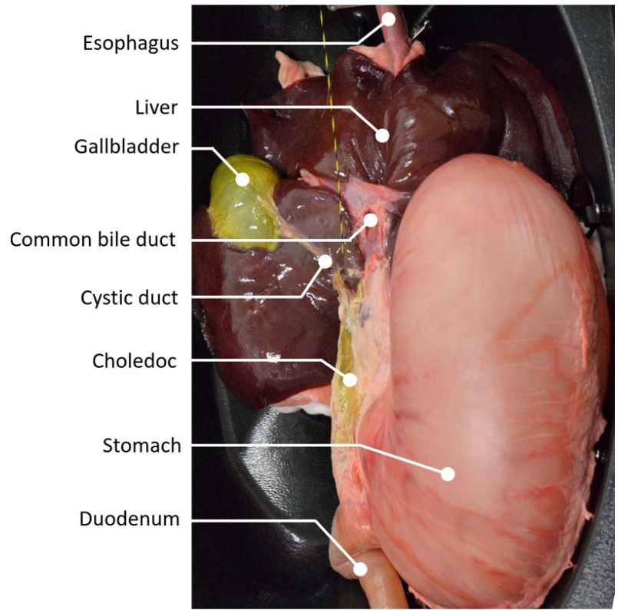
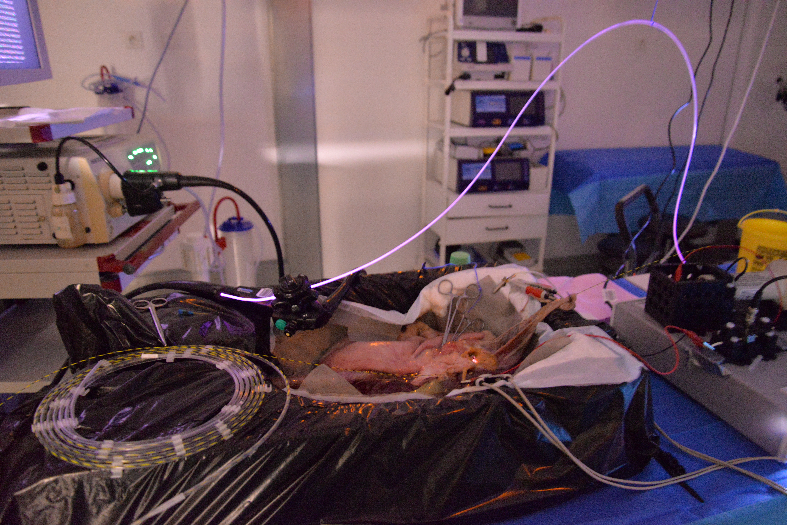
Post-mortem digestive model
11/22
A mandatory milestone to refine plasma parameters
Medical
context
Endoscopy column
Knowledge
gap
Plasma catheter
model
Artificial biliary
Post-mortem digestive
Duodenoscope
model
Digestive porcine model
model
Digestive porcine model
PELP
(Plasma EndoLuminal Procedure)
Porcine

Slide 23
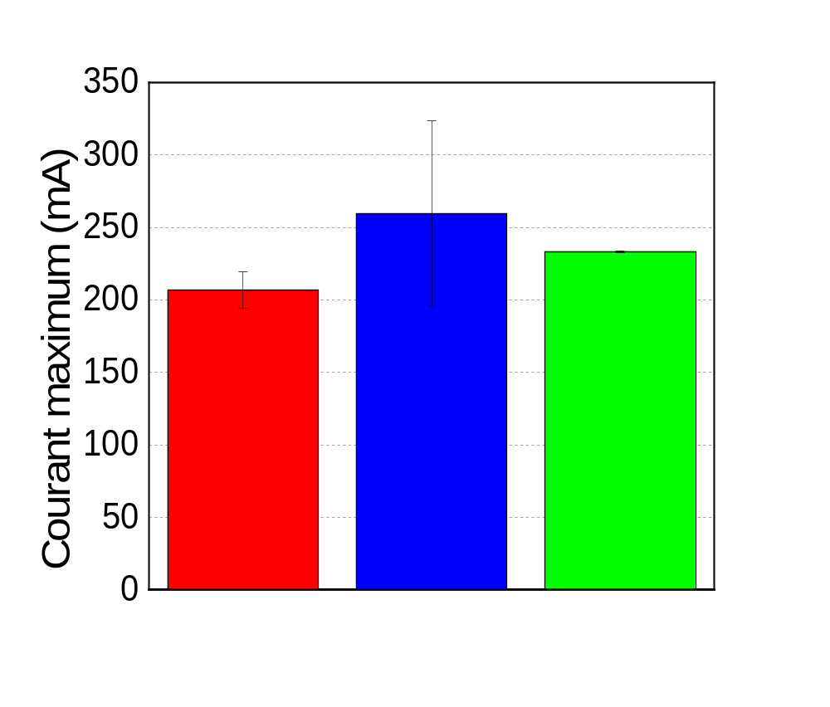
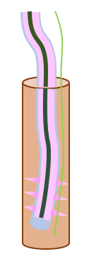

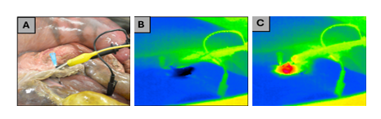
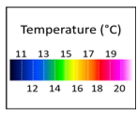
Post-mortem digestive model
12/22
Defining the safe operating window
Medical
context
Electrical measurements (6 kV, 5 kHz, 10%)
Thermal measurements (6 kV, 5 kHz, 10%)
Knowledge
gap
Maximum current (mA)
T(t) – T_{t=0min} (°C)
model
Artificial biliary
B
C
Post-mortem digestive
model
Time (min)
A
B
C
model
Porcine

Slide 24
Alive porcine model
13/22
Can we endoscopically deliver plasma into porcine bile duct?
Medical
Context
Hôpital Européen Georges Pompidou (HEGP)
4 experimental campaigns
18 healthy domestic pigs weighing 25-30kg
  7 pigs: optimization
  11 pigs: replication
context
N = 7 pigs
Knowledge
Histological
analysis
gap
Short-term side effects?
Autopsy
Plasma EndoLuminal Procedure (PELP)
Euthanasia
model
Animal acclimatization period
(10 days)
Artificial biliary
Anesthesia: 1-2h
Gas delivery: 10-30 min
Plasma therapy: 5 min
Long-term side effects?
Post-mortem digestive
40days
of monitoring
including blood
samplings
model
Histological
analysis
N = 4 pigs
model
Euthanasia
Autopsy
Porcine

Slide 25
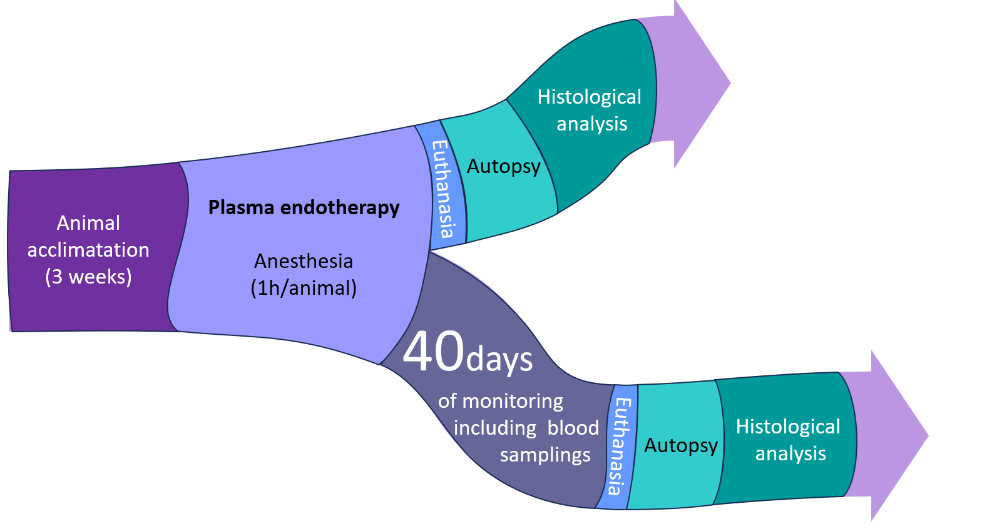
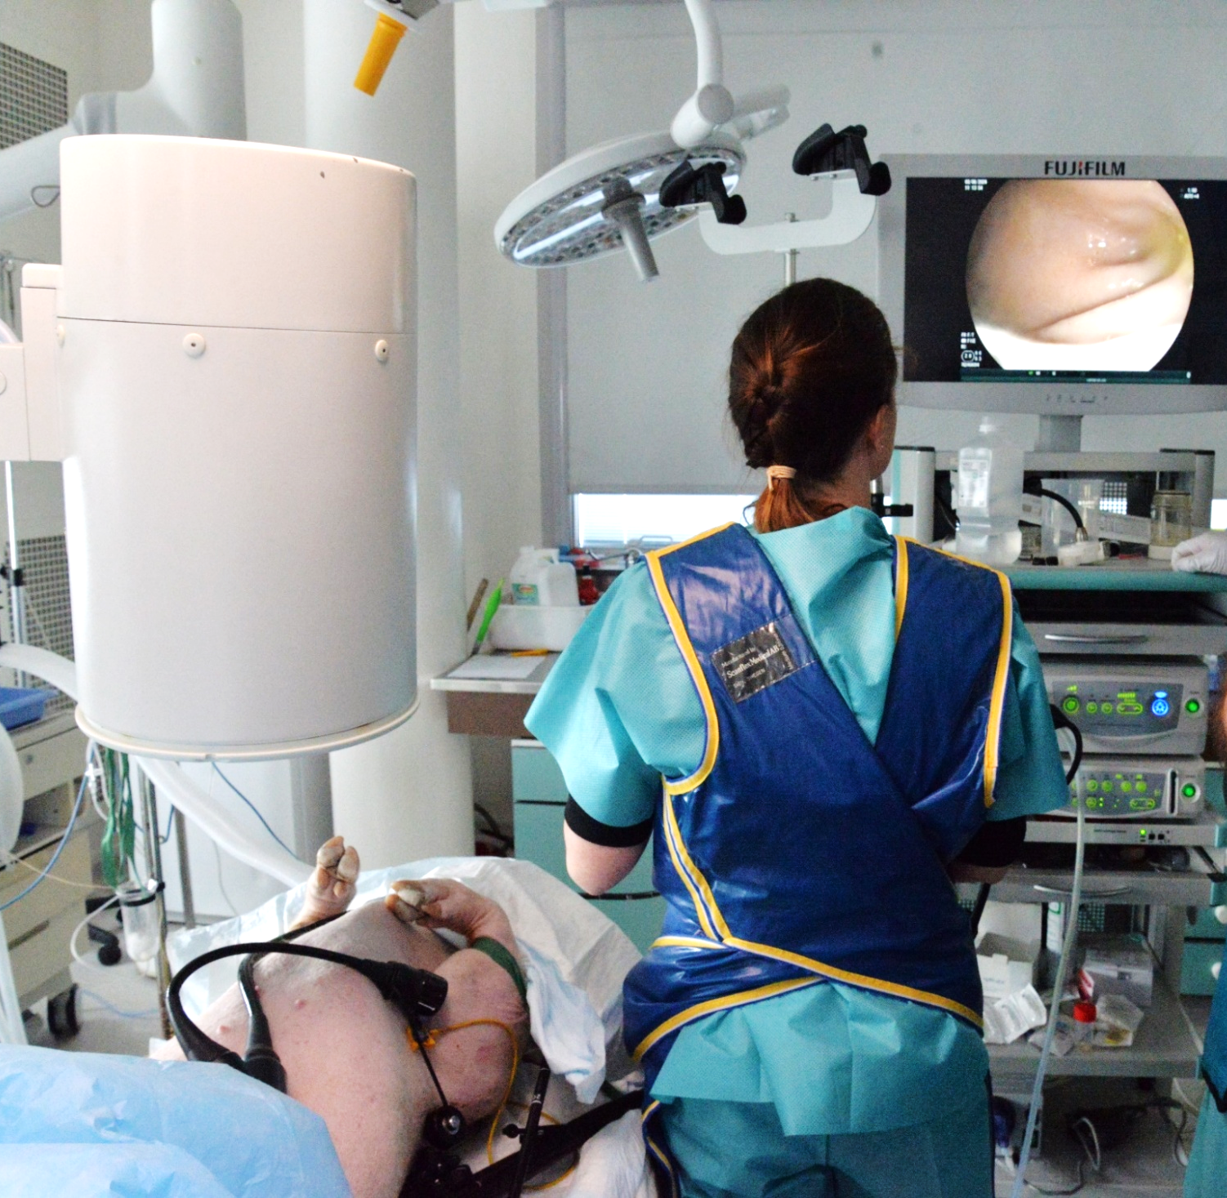
Alive porcine model
14/22
Can we endoscopically deliver plasma into porcine bile duct?
Medical
Plasma EndoLuminal Procedure (PELP)
Plasma-assisted endoscopic retrograde cholangiopancreatography
context
X-ray imaging system
Endoscopic column
Knowledge
gap
Plasma EndoLuminal Procedure (PELP)
model
Artificial biliary
Anesthesia: 1-2h
Gas delivery: 10-30 min
Plasma therapy: 5 min
Post-mortem digestive
model
model
Porcine
Porcine model
George Pompidou European Hospital (Paris). Marine Camus, MD in digestive endoscopy, St-Antoine Hospital (Paris)

Slide 26
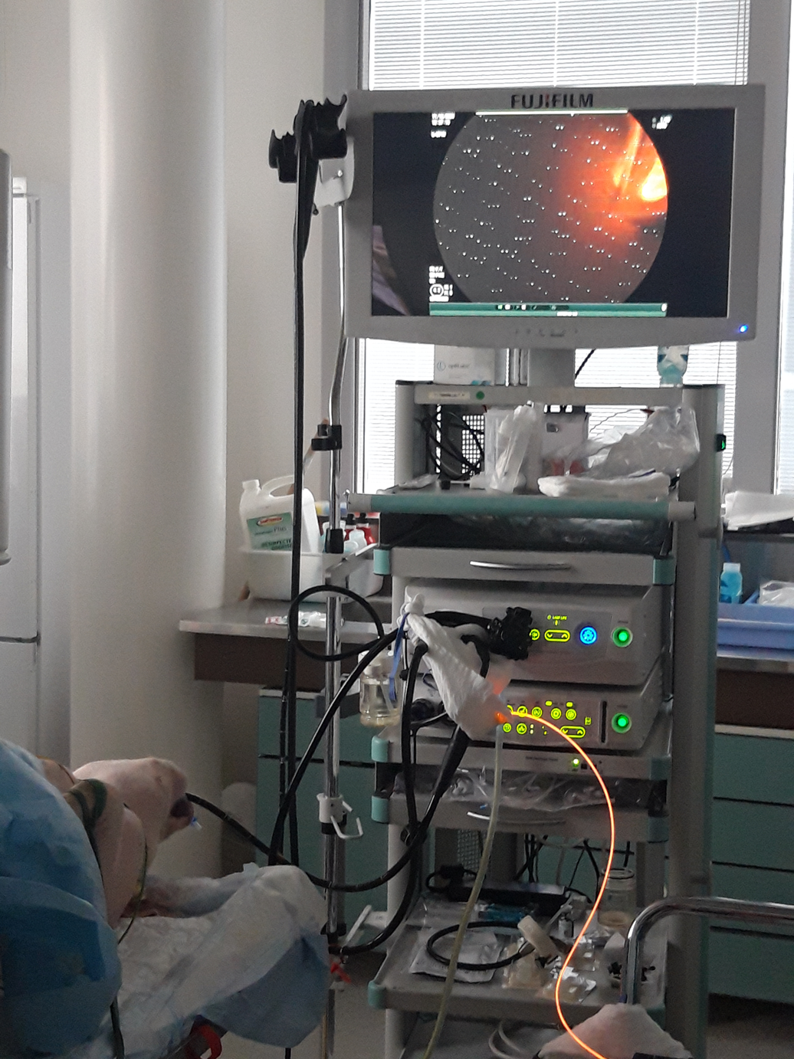

Alive porcine model
15/22
Can we endoscopically deliver plasma into porcine bile duct?
Medical
Plasma EndoLuminal Procedure (PELP)
Plasma-assisted endoscopic retrograde cholangiopancreatography
context
X-ray imaging system
Endoscopic column
Knowledge
gap
model
Artificial biliary
Post-mortem digestive
model
Duodenal
papilla
model
Porcine
Porcine model
Duodenoscope camera
George Pompidou European Hospital (Paris). Marine Camus, MD in digestive endoscopy, St-Antoine Hospital (Paris)

Slide 27

Alive porcine model
15/22
The 4 challenges we had to face with …
Medical
Challenge #1: Localize the duodenal papilla and enlarge it with ad hoc endoscopic tools
context
Knowledge
gap
Duodenal
papilla
model
Artificial biliary
Post-mortem digestive
model
Duodenal
papilla
model
Porcine
Duodenoscope camera

Slide 28




Alive porcine model
15/22
The 4 challenges we had to face with …
Medical
Challenge #1: Localize the duodenal papilla and enlarge it with ad hoc endoscopic tools
context
Knowledge
gap
Duodenal
papilla
model
Challenge #3: Find a balance between gas flow rate, gas injection time and pressure
Artificial biliary
Challenge #2: Insert the plasma catheter in the papilla
Post-mortem digestive
model
Plasma catheter
Duodenal
papilla
model
Porcine
Duodenoscope camera

Slide 29



Alive porcine model
15/22
The 4 challenges we had to face with …
X-rays
Medical
Without contrast agent
context
Guidewire
Endoscope
Knowledge
gap
Plasma
catheter
model
Artificial biliary
With contrast agent
Guidewire
& catheter
No more camera in the biliary tree ⇒ Challenge #4: How to navigate the plasma catheter?
Post-mortem digestive
model
Endoscope
Common
bile duct
model
Porcine

Slide 30
Alive porcine model
16/22
How about potential side effects?
Medical
context
Knowledge
Histological
analysis
gap
Autopsy
Plasma EndoLuminal Procedure (PELP)
Euthanasia
model
Animal acclimatization period
(10 days)
Artificial biliary
Anesthesia: 1-2h
Gas delivery: 10-30 min
Plasma therapy: 5 min
Post-mortem digestive
40days
of monitoring
including blood
samplings
model
Histological
analysis
model
Euthanasia
Autopsy
Porcine

Slide 31

Alive porcine model
16/22
How about potential side effects?
Medical
context
7 kV, 5 kHz, 10%, He flow rate = 0.7 slm, N=11
Knowledge
Histological
analysis
gap
Autopsy
Plasma EndoLuminal Procedure (PELP)
Euthanasia
model
Animal acclimatization period
(10 days)
Artificial biliary
Anesthesia: 1-2h
Gas delivery: 10-30 min
Plasma therapy: 5 min
Post-mortem digestive
40days
of monitoring
including blood
samplings
model
Histological
analysis
model
Euthanasia
Autopsy
Porcine

Slide 32




Alive porcine model
16/22
How about potential side effects?
Medical
context
Before During After
Max
Knowledge
Histological
analysis
gap
Autopsy
Min
Plasma EndoLuminal Procedure (PELP)
Euthanasia
model
Animal acclimatization period
(10 days)
Artificial biliary
Anesthesia: 1-2h
Gas delivery: 10-30 min
Max
Plasma therapy: 5 min
Min
Post-mortem digestive
40days
of monitoring
including blood
samplings
model
Histological
analysis
Before During After
model
Euthanasia
Autopsy
Porcine

Slide 33


Alive porcine model
16/22
How about potential side effects?
Medical
context
Cholangiograms
Knowledge
Histological
analysis
gap
Before PELP
After PELP
Autopsy
Plasma EndoLuminal Procedure (PELP)
Euthanasia
model
Animal acclimatization period
(10 days)
Artificial biliary
Anesthesia: 1-2h
Gas delivery: 10-30 min
Plasma therapy: 5 min
Post-mortem digestive
40days
of monitoring
including blood
samplings
model
No perforation of the biliary tract
Histological
analysis
model
Euthanasia
Autopsy
Porcine

Slide 34


Alive porcine model
17/22
How about potential side effects?
Medical
context
1 cm
Gallbladder
Knowledge
Histological
analysis
gap
Choledoc
Autopsy
Plasma EndoLuminal Procedure (PELP)
Euthanasia
Duodenal papilla
model
Animal acclimatization period
(10 days)
Artificial biliary
Anesthesia: 1-2h
Gas delivery: 10-30 min
1 cm
Plasma therapy: 5 min
Post-mortem digestive
40days
of monitoring
including blood
samplings
model
Histological
analysis
model
Euthanasia
Autopsy
Porcine

Slide 35


Alive porcine model
18/22
How about potential side effects?
Medical
context
 | Sham biliary tissue | Plasma-treated biliary tissue
Luminal epithelium | • Mostly continuous and preserved biliary epithelial lining. • No epithelial denudation or ulceration. | • Largely preserved, but the luminal surface appears more irregular, folded, and reactive. • No obvious full-thickness epithelial loss.
Subepi-thelial stroma | Pink fibroconnective layer, with scattered nuclei and small vessels. | • Possible mild inflammatory /vascular changes. • Some congestion can be observed, suggesting a limited tissue response after plasma.
Periductal connective tissue | Preserved periductal architecture with gland-like structures, vessels, and connective tissue. | • Overall architecture remains recognizable. • No obvious transmural destruction or necrosis
Adipose tissue | Deep layer composed of clear vacuolated adipocytes surrounding the biliary wall. | Structurally preserved. No obvious plasma-induced damage.
SHAM biliary tissue, 30 min later
Luminal epithelium
Subepithelial stroma
Knowledge
Histological
analysis
gap
Periductal connective tissue
Autopsy
Plasma EndoLuminal Procedure (PELP)
Euthanasia
model
Animal acclimatization period
(10 days)
Adipose tissue
Artificial biliary
100 µm
Anesthesia: 1-2h
PELP Biliary tissue 30 min later
Gas delivery: 10-30 min
Largely preserved even if more irregular, folded & reactive.
Plasma therapy: 5 min
Post-mortem digestive
40days
of monitoring
including blood
samplings
model
Mild vascular congestion / inflammatory reaction.
Architecture preserved. No obvious transmural destruction or necrosis
Histological
analysis
model
Euthanasia
Autopsy
Porcine
Structurally preserved. No obvious plasma-induced damage.
200 µm

Slide 36

Alive porcine model
19/22
How about potential side effects?
Medical
context
40 days of monitoring
(Veterinary supervision: staff of Georges Pompidou European Hospital)
Cell damage?
Knowledge
Histological
analysis
gap
Liver disorder ?
Feeding
Health
Autopsy
Plasma EndoLuminal Procedure (PELP)
Euthanasia
model
Animal acclimatization period
(10 days)
Artificial biliary
Well-being
Anesthesia: 1-2h
Liveliness
Gas delivery: 10-30 min
Plasma therapy: 5 min
Post-mortem digestive
Social behavior
40days
of monitoring
including blood
samplings
model
No pain signs
Histological
analysis
model
Euthanasia
Autopsy
Porcine
All parameters remained consistent with a positive welfare profile.

Slide 37

Alive porcine model
20/22
How about potential side effects?
Medical
context
Day 1
Day 40
Knowledge
Histological
analysis
gap
Autopsy
Plasma EndoLuminal Procedure (PELP)
Euthanasia
model
Animal acclimatization period
(10 days)
Artificial biliary
Anesthesia: 1-2h
Gas delivery: 10-30 min
No macroscopic damage
Plasma therapy: 5 min
Post-mortem digestive
40days
of monitoring
including blood
samplings
model
Histological
analysis
model
Euthanasia
Autopsy
Porcine

Slide 38

Alive porcine model
21/22
How about potential side effects?
Medical
context
SHAM: biliary tissue 40 days later
Knowledge
Histological
analysis
gap
Autopsy
Compared with SHAM tissue
• Increased of thickening of the subepithelial/periductal stroma → Mild chronic reparative or fibrotic response
• No obvious ulceration, transmural necrosis, hemorrhage or deep structural destruction
Plasma EndoLuminal Procedure (PELP)
Euthanasia
Animal acclimatization period
(10 days)
model
100 µm
Artificial biliary
PELP: biliary tissue 40 days later
Anesthesia: 1-2h
Gas delivery: 10-30 min
Plasma therapy: 5 min
Post-mortem digestive
40days
of monitoring
including blood
samplings
model
Histological
analysis
model
Euthanasia
Autopsy
Porcine
200 µm

Slide 39
Conclusion & Outlooks
22/22
STRENGTHS
WEAKNESSES
Murine models: antitumor effects demonstrated
Porcine models: electrical & thermal risks controlled under bile flow constraints → No side effects
Plasma catheter fully matches with conventional endoscopic material
Alive porcine models
  Chemical environment unknown → Which ROS are plasma-generated?
  In situ & real time measurements of plasma parameters remains challenging
EMR
OPPORTUNITIES
THREATS
Combo : plasma (local) + immunotherapy (systemic)
2 patents, maturation starting in 3 months (certification & pre-industrial catheter)
Clinical trials expected in 2 years
Spinoffs: pulmonary cancer (NSCLC)
Trade-off: therapeutic efficacy vs Anesthesia
Shortage & volatility of helium gas
From bench to bedside: will preclinical antitumor efficacy be the same on patients?

Slide 40

17/22
Thank you for your attention

